Slide 1
Survey Report
Safety & Compliance Assessment at Amazon Sorting Warehouse
June 26, 2025

Slide 2

Survey Objective – Amazon Warehouse Safety & Compliance
1
Assessment Focus
Evaluate current safety and compliance processes in in-warehouse vehicle movement
Identify manual dependencies, risks, and lack of traceability
$
2
Gap Identification
Outcome Expectation
Highlight areas with missing audit trail, unstructured escalation, and non-standardized compliance checks
Observe gaps in vehicle, driver, seal, and dock-side safety validation
Achieve SOP standardization, real-time visibility, SLA-based escalation, and field-level safety empowerment
Build a command-grade, audit-ready logistics ecosystem
Strengthen safety governance through proactive monitoring, surprise audits, and incident accountability
3
Digital Transformation Goal
Propose a tech enabled digital solution to enhance safety & enforce compliance
Replace manual checks with API-based validations and mobile-enabled audits

Slide 3



Current Warehouse Workflow
Outbound Process
Inbound Process
No photographic evidence or audit trail maintained.
No system-driven turn management or idle time tracking.
No system-driven audit trail maintained for exception
No system-driven turn management or idle time tracking.
Gate In
Parking
Gate In
Parking
Manual compliance checks for PUC, RC, blacklist status, driver sobriety, vehicle type, e-seal, container condition.
Issues are escalated over WhatsApp to L1/L2 personnel.
Vehicle waits for dock assignment.
Manual call by admin team as per requirement.
Truck validated via app, seal condition checked.
Broken seals are escalated, but alerts are manually handled.
Vehicle waits in queue without automated tracking.
No digital validation or evidence or audit trail.
No digital validation or evidence or logging.
Gate Out
Loading Dock
Gate Out
Unloading Dock
Final checks of lock and consignment challan before exit.
Driver submits keys to ops team.
Loading is completed and e-seal is applied manually.
Keys and challan are handed back to the driver.
Exit permitted post-unloading without compliance reconfirmation.
Keys taken from driver, unloading is manual.
No timestamped logs or traceability.

Slide 4






Key Gaps Identified
Parameter
Gap Identified
Solution
 | Vehicle Compliance | Manual checks without digital proof or validation via official records. |  | Real-time validation via ULIP & Vahan APIs & Amazon internal data library
 | Driver Verification | No integration with license or offence history databases. |  | API integration for license and offence verification
 | Audit & Evidence | No timestamped photo/video records maintained. |  | Photo/video capture with timestamp and user ID for each event
 | Escalation Handling | Informal WhatsApp-based flow with no SLA or audit trail. |  | SLA-based escalation module with L1–L3 routing and resolution tracking
 | Surprise Audits | No tool for Road Safety Ambassadors (RSA) to perform random checks or log findings. |  | Mobile audit app for field inspection, reporting and documentation
 | TAT Tracking | No gate-to-gate time measurement; inefficiencies go unnoticed. |  | Stage-wise TAT capture from Gate-In to Gate-Out for performance analysis

Slide 5





Benefits of Axestrack Digital Solution
Enforced SOP Compliance
Audit-Ready Records
Tamper-Proof Monitoring
Real-Time Visibility
Empowered Safety Teams
Digital checkpoints ensure rule-based operations
Timestamped logs, photo/video evidence, and compliance history
Alerts and RCA trail for e-seal and consignment handling
Dashboards for safety performance, violation trends, and escalations
Mobile tools to inspect, record, and report field audits.

Slide 6
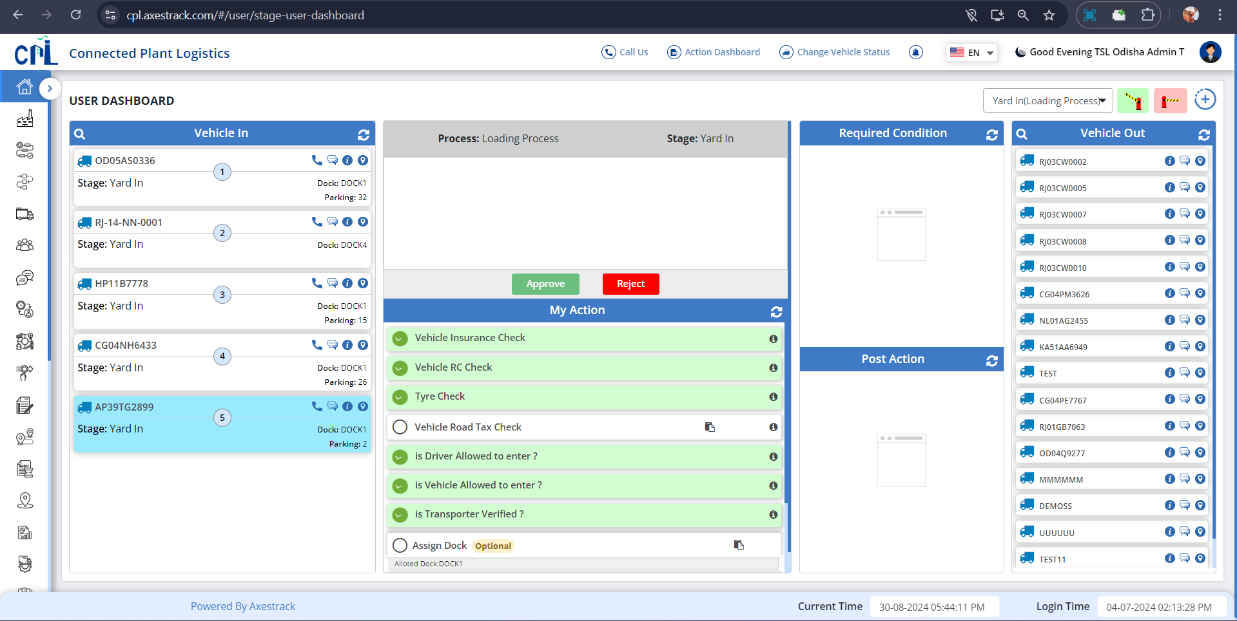
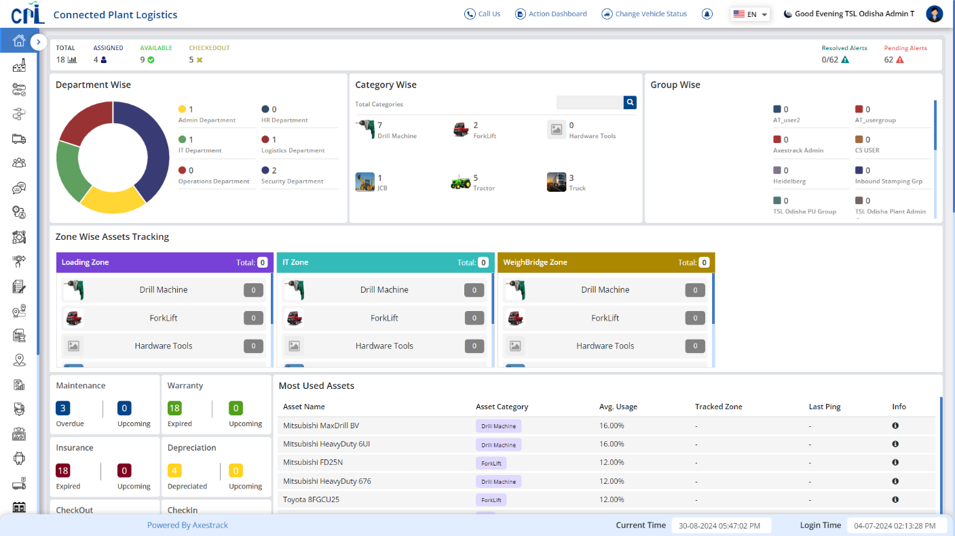
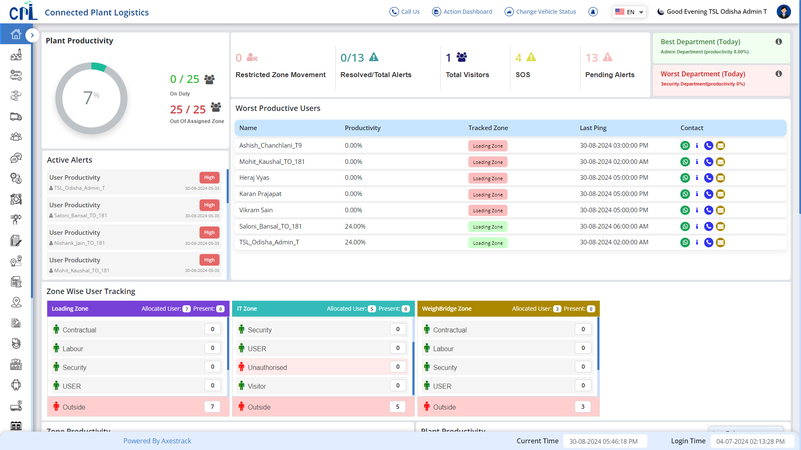
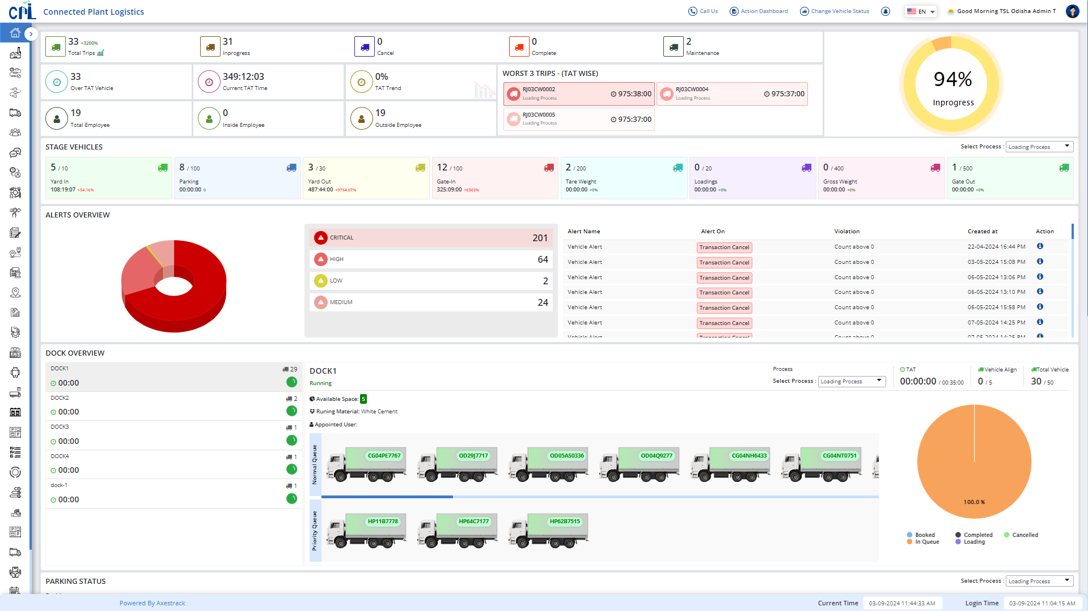
One Stop Solution for Plant & Assets Visibility…
Asset Tracking Dashboard
Gate Entry Dashboard
User Tracking Dashboard
Summary Dashboard
Our dashboards provides complete control & visibility across all processes including Vehicle, Employee & Asset tracking

Slide 7
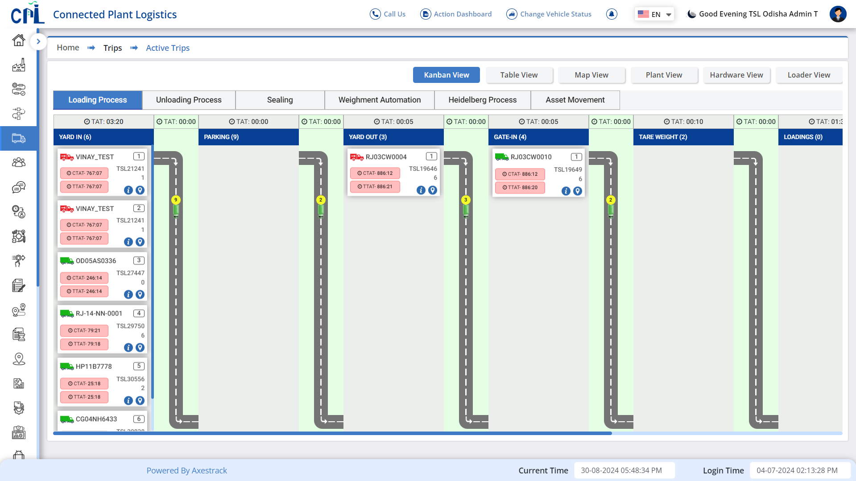
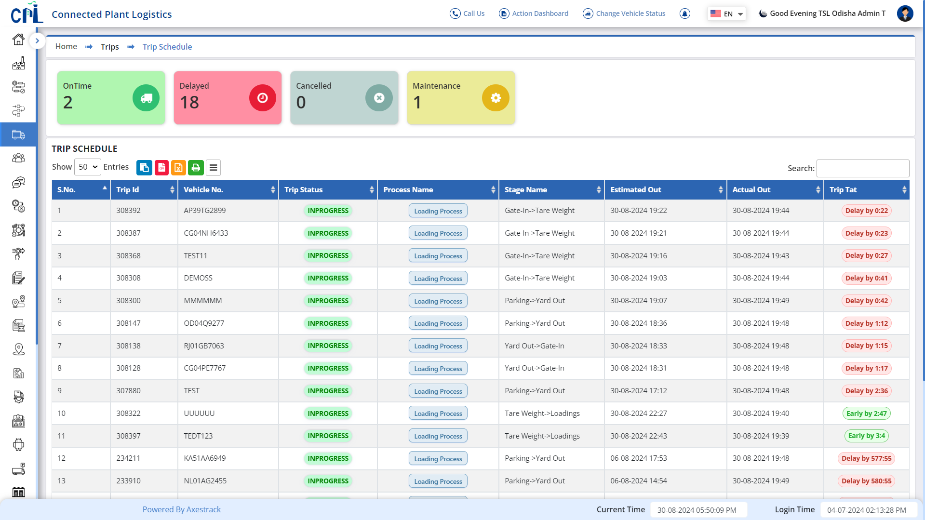
In-Plant Trip Management
Stage-based tracking to help you measure, analyze and reduce Turnaround Time
Trip Schedule dashboard
Trip Management dashboard
Real Time Trip Status for actively validate bottlenecks and take optimization actions to reduce detentions and streamline the processes.

Slide 8
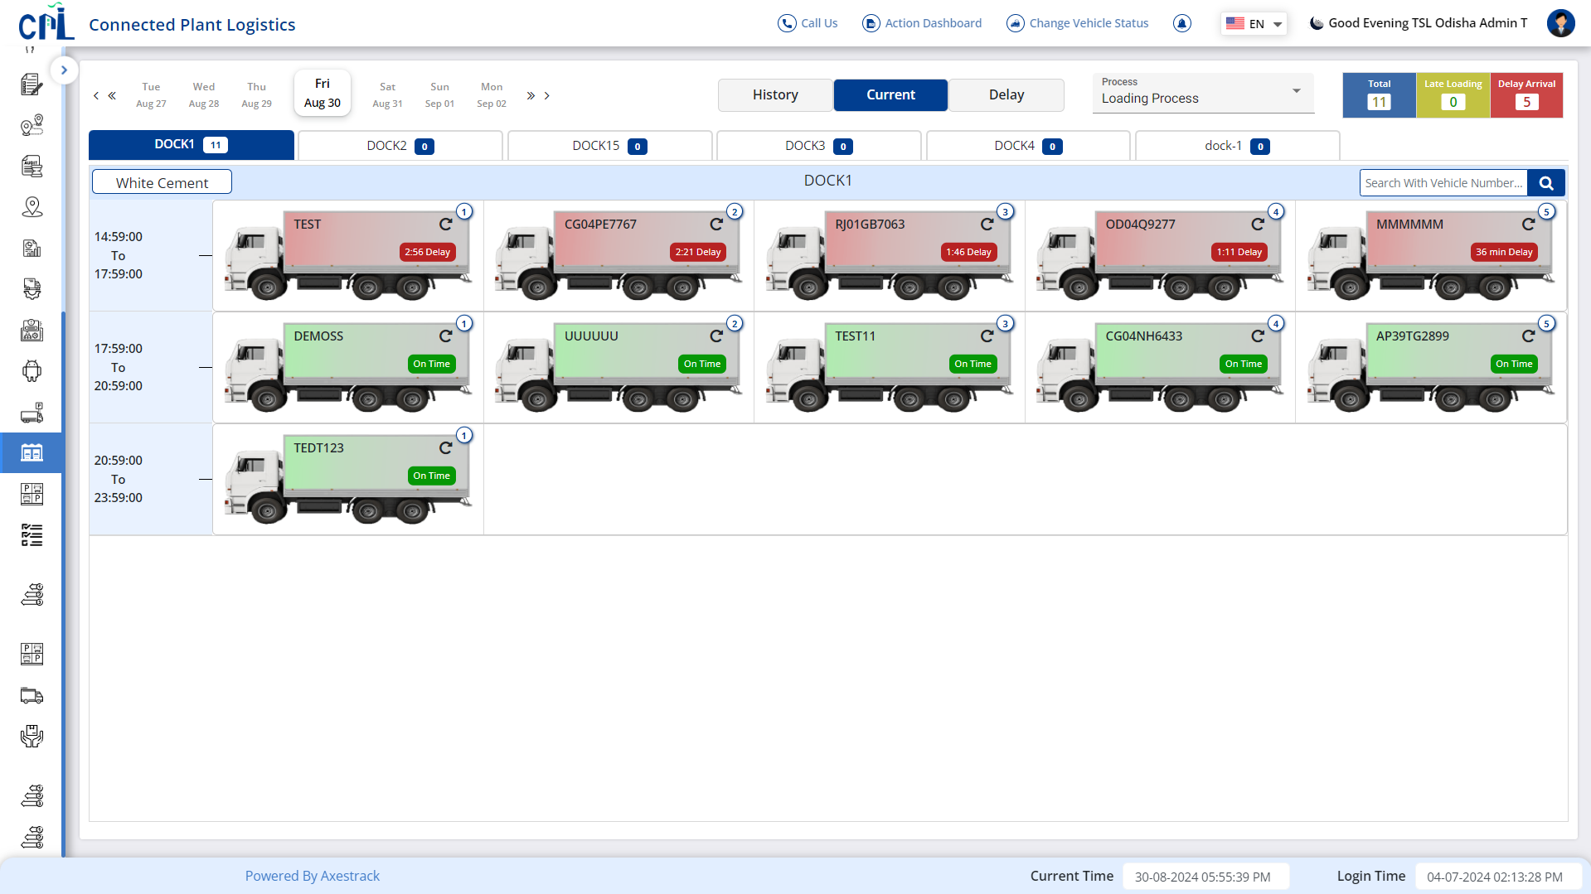
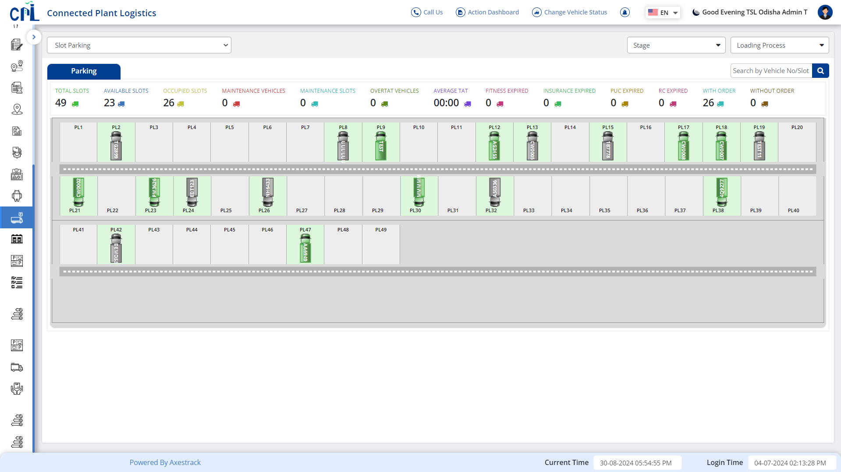
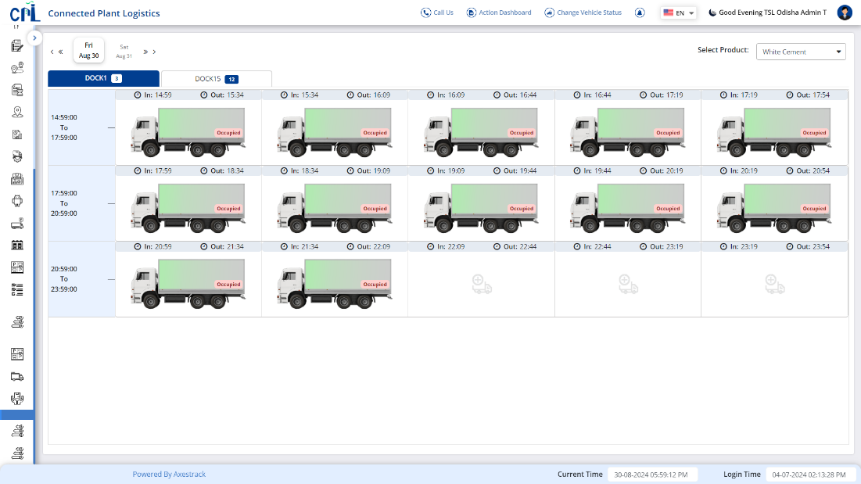
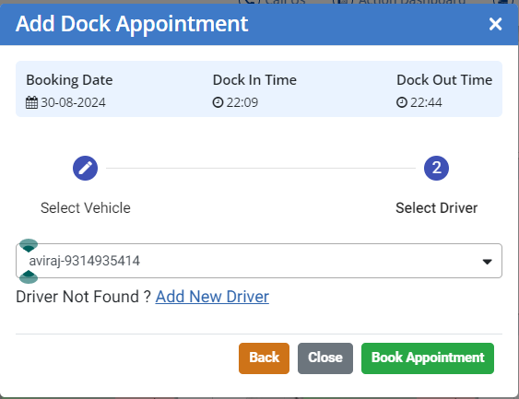
SMART Dock & Parking Management
Managing parking and dockyard slots to reduce idle time and ensure smooth vehicle movement for loading and unloading materials.
Parking dashboard
Dock Management dashboard

Slide 9
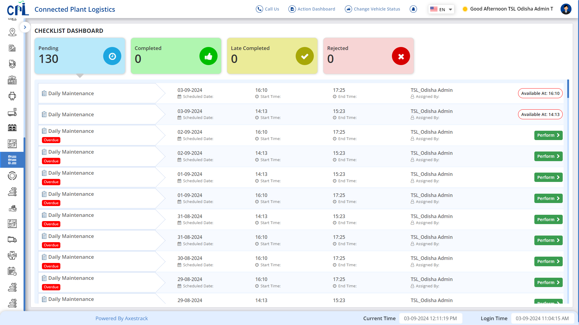
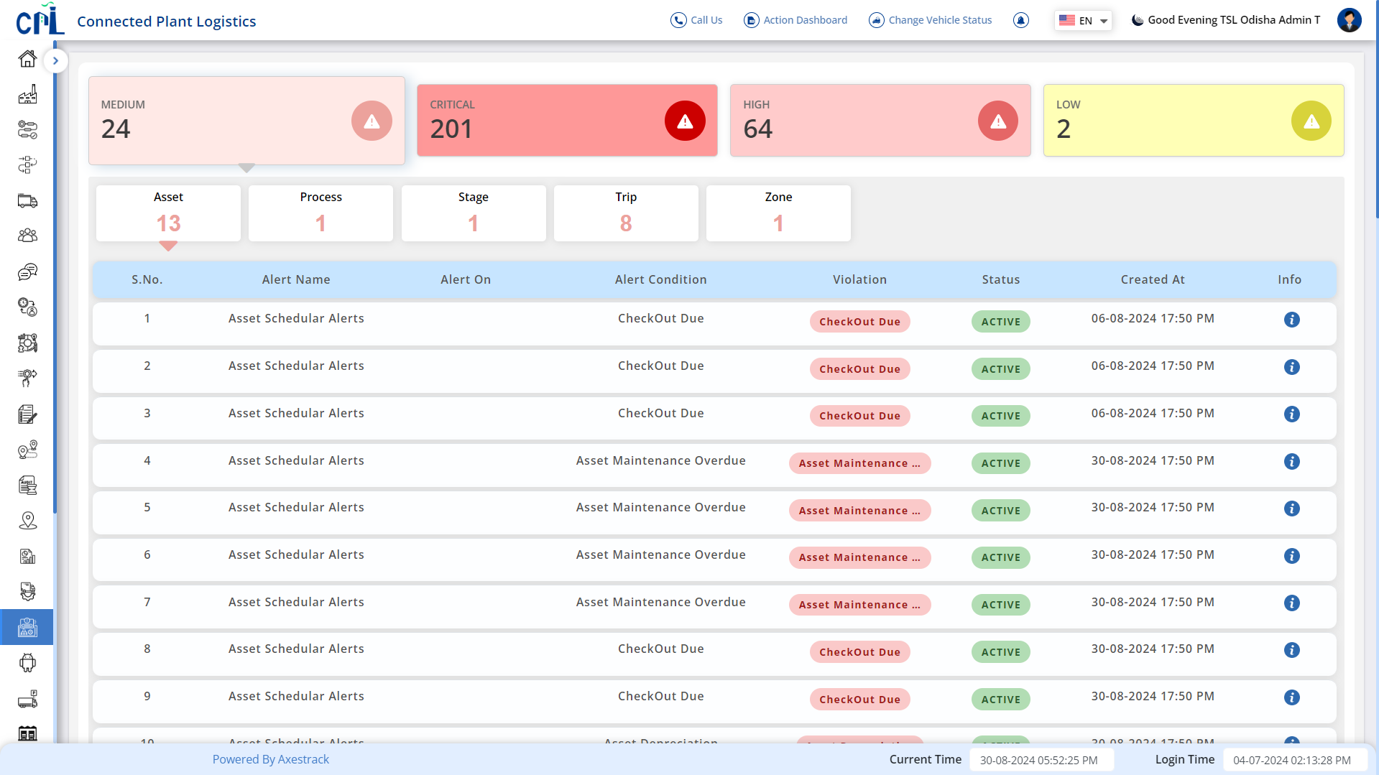
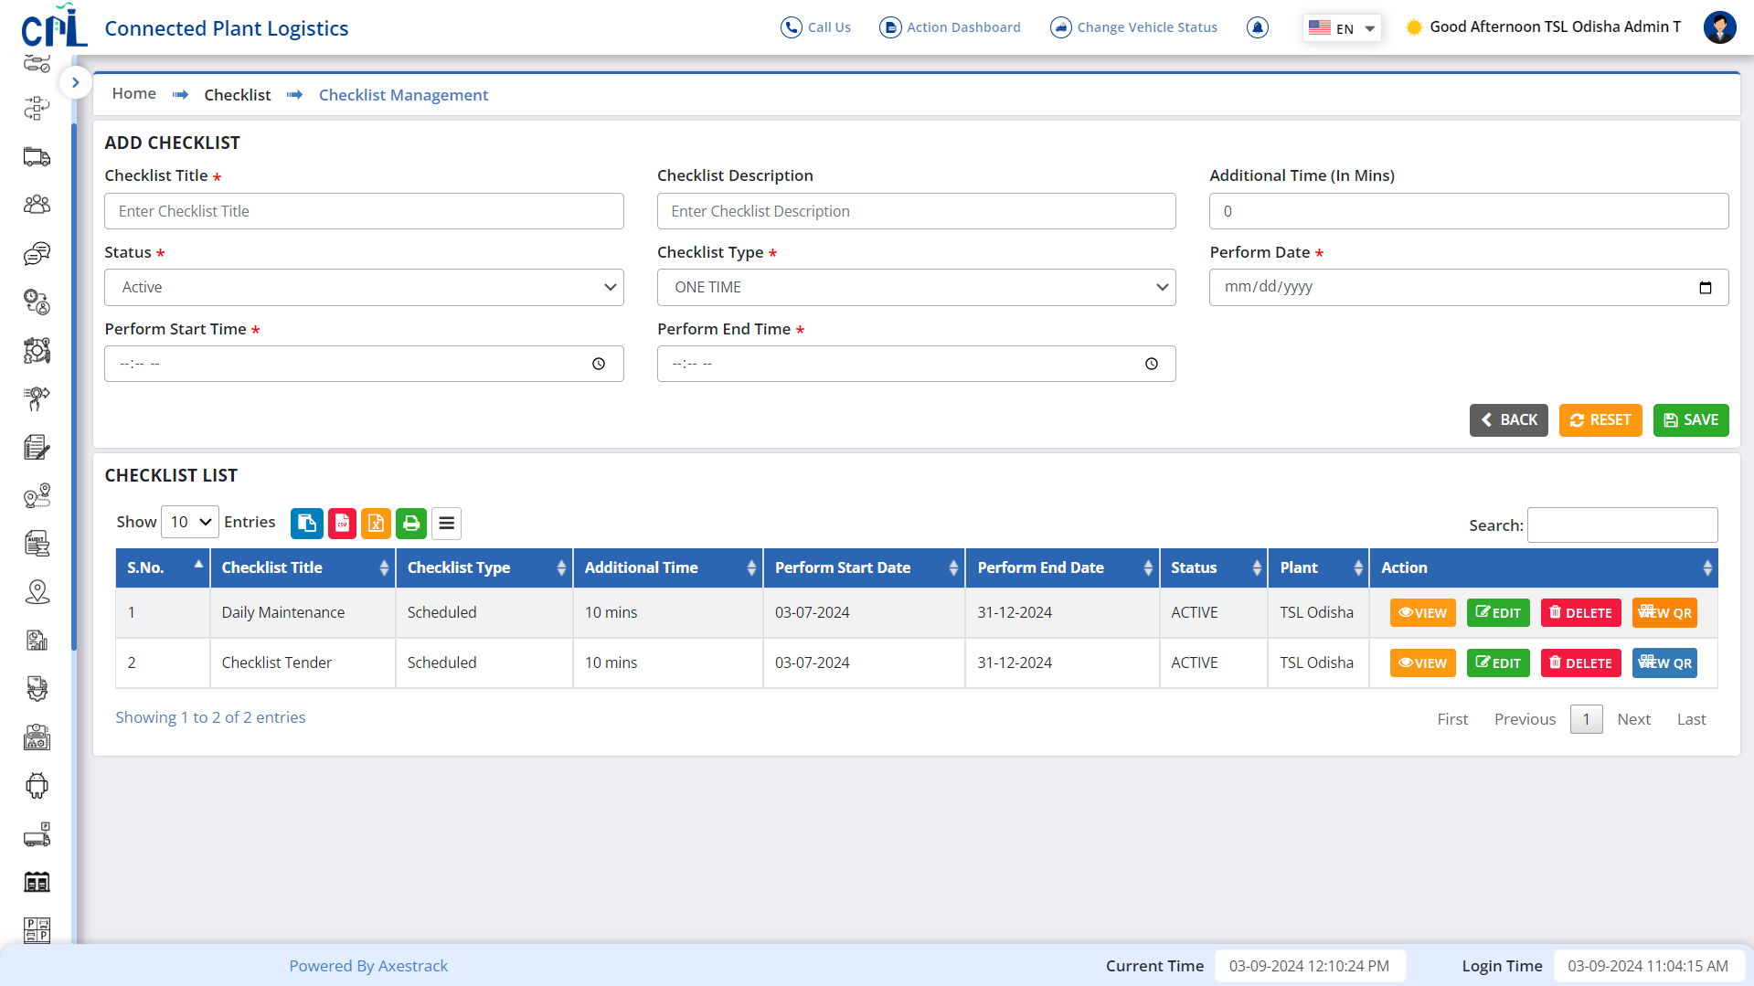
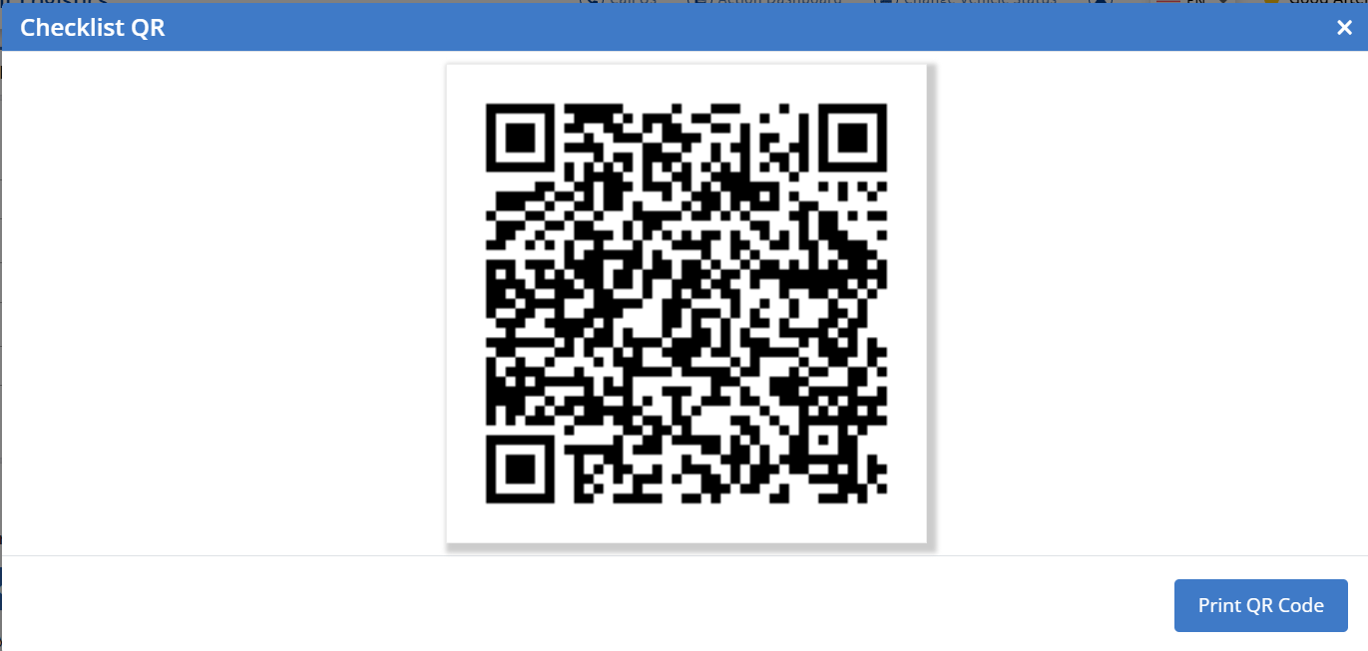
Checklist & Alerts Dashboard
Optimize Entry/Exit Time and Process for Fleets & proactive Alerts Dashboard for any violations
Alert dashboard
Checklist dashboard

